Slide 1

Reporting Requirements for Multi-State Businesses
Unitary Combined and Elective Consolidated Returns
For DOR Internal Training Purposes Only
October 2019
Kentucky Department of Revenue • 501 High Street • Frankfort, KY 40601 • (502) 564-8139

Slide 2

HB
Disclaimer
The information in this presentation is for educational and informational purposes only and does not constitute legal advice. Information is presented as an overall review that is subject to law changes and may not apply to all states. For accurate information on issues related to combined unitary and elective consolidated filing, please reference KRS 141.201, KRS 141.202, 103 KAR 16:200, and 103 KAR 16:400.
Information in this presentation is believed to be accurate as of the date of publication. In the event that any information in this presentation is later determined to be in error, this presentation cannot be used by taxpayers in supporting a specific position or issue before the Department of Revenue, as it does not have the statutory or regulatory authority.

Slide 3

Reporting for Multi-State Businesses
Long Live Unitary Combined…?
Mandatory Nexus is Dead…

Slide 4
HB
The end of mandatory nexus filing
2018 HB 487 changed the filing requirements for corporations doing business in Kentucky and in other states
For tax years beginning on or after January 1, 2019, these corporations must file combined unitary returns, unless they elect to file same-as-federal consolidated returns
This marks the end of the mandatory nexus consolidated returns required for tax years beginning on or after January 1, 2005 and ending on or before December 31, 2018

Slide 5
HB
The end of mandatory nexus filing
KRS 141.200 required mandatory nexus filing
Mandatory nexus: one or more chains of includible corporations connected through stock ownership or membership/partnership interest with a common owner that is also an includible corporation
All includible corporations have sales, property, or payroll in Kentucky or are domiciled in KY or derive income from sources in Kentucky

Slide 6
The end of mandatory nexus filing
From the audit point of view:
  A company was included in a nexus group:
    If the affiliation schedules (Forms 851 and 851-K) showed 80% ownership structure; AND
    If the affiliate had either sales*, property, or payroll in Kentucky (Sch A-N or page 2, Sch A), OR was domiciled in Kentucky
    *unless the company was protected by P.L. 86-272

Slide 7
Unitary Combined
Applicable statute: KRS 141.202. Applicable regulation: 103 KAR 16:400
For tax years beginning on or after January 1, 2019:
  KRS 141.202(3)(a): “a taxpayer engaged in a unitary business with one (1) or more other corporations shall file a combined report which includes … all corporations that are members of the unitary business”
  A unitary group can include entities that do not have sales, property, or payroll in Kentucky
  It can also include entities that are less than 80% owned by another entity within the group
    KRS 141.202 (2)(f) refers to “separate parts of a single corporation” or “a commonly controlled group of corporations”
    KRS 141.202(2)(a) defines control as more than 50% ownership by a common owner or owners
  Intercompany transactions among members of a combined group are eliminated when the entities are combined

Slide 8
What Is a Unitary Business?
KRS 141.202(2)(f): "Unitary business means a single economic enterprise that is made up either of separate parts of a single corporation or of a commonly controlled group of corporations that are sufficiently interdependent, integrated, and interrelated through their activities so as to provide a synergy and mutual benefit that produces a sharing or exchange of value among them and a significant flow of value to the separate parts.”

Slide 9
What Is a Unitary Business?
103 KAR 16:400
Three characteristics of unitary business
  Functional integration: Are business functions interdependent?
  Centralized management: Who makes the decisions?
  Economies of scale: Are there efficiencies gained by ownership of different companies?

Slide 10
What Is a Unitary Business?
Clues that may indicate a unitary business:
Companies engaged in the same line or similar lines of business.
Companies engaged in different steps of a vertically structured business.
Companies controlled by strong centralized management.
Economies of scale that allow for mutual benefit to companies.
One company exercises significant control over another company or companies.
Companies engaged in intercompany business transactions, particularly relating to products, services, intellectual property, or financing that are significant to the businesses’ operations.

Slide 11
Who is in the combined group?
A combined group is the group of all companies that have common ownership and are engaged in a unitary business, where at least one company is subject to the tax imposed by KRS 141.040.
A combined group includes only corporations, the voting stock of which is more than fifty percent (50%) owned, directly or indirectly, by a common owner or owners.
The apportionable income of a corporation in a combined group includes its distributive share of the income from a pass-through entity of which it is a shareholder or member

Slide 12
Who is in the combined group?
Kentucky defines the group on a water’s edge basis, meaning that entities in the group should be incorporated in the United States, the District of Columbia, or an overseas possession of the United States
  Except…a domestic company that earns 80% or more of its income from foreign sources is excluded from the group
The combined group also includes those entities that are part of the unitary business doing business in a tax haven
  But wait…any country with a comprehensive income tax treaty with the United States is not a tax haven
Plus, any entity that derives more than 20% of its income from other members of the unitary group for “intangible property or service related activities that are deductible against the apportionable income of other members of the combined group” must be included in the combined report to the extent of that income [KRS 141.202(8)(b)]
  Unless it is a non-US entity operating in a country with a comprehensive income tax treaty with the United States

Slide 13
Tax Havens
Unitary business
>80% income = foreign source
Commonly Controlled (50%)
Tax treaty
Water’s Edge
Combined
Group
Income from I/C Intangible > 20%
Proportionate share of income from PTEs

Slide 14
Who is in the combined group?
From the audit point of view:
  An entity is included in the combined group:
    If it is a corporation (or a pass-through entity electing to be taxed as a corporation)
    The affiliation schedule (Schedule U2) shows >50% ownership structure
  HOWEVER:
    The exact composition of a combined group depends on the fact pattern for each particular taxpayer
    DOR desk auditors generally will not have access to the in-depth corporate information required to determine which entities properly belong in the combined group

Slide 15
The combined group
Membership in a combined group is divided between taxpayer members and non-taxpayer members
  “Taxpayer members” are those subject to KY tax (i.e. corporations with nexus in KY)
  Non-taxpayer members participate in the unitary business but are not subject to tax in KY
All taxpayer members must have a Kentucky Corporate account number
  Non-taxpayer members are not required to register and obtain a Kentucky CP/LLET number

Slide 16
What is apportionable income?
Updated terminology for “business income”
Apportionable income is income arising from the normal course of the unitary business’s activities
The apportionable income of the combined group is the sum of the separate net incomes of all members of the combined group, including taxpayer and nontaxpayer members.
Each member of the combined group calculates its net income as if it were filing a separate Kentucky corporate income tax return (with some exceptions in the treatment of gains and losses and charitable contributions)

Slide 17
What is apportionable income?
Items not included in apportionable income:
  Allocated non-apportionable income (FKA non-business income), less any related expense or loss
  Allocated income sourced to Kentucky from sale or exchange of capital assets and from involuntary conversions
  Separately apportioned income derived from participation in another unitary business
    Yes, an affiliate could be a member of more than one unitary business
  Separately apportioned income from a distinct business activity conducted wholly by the taxpayer
  Separately apportioned share of income from sale or exchange of capital assets and from involuntary conversions

Slide 18
Unitary Combined
The impact of the change from mandatory nexus to unitary combined:
  Each taxpayer member will calculate its own apportionment factor under unitary combined
  Will increase the denominator (sales everywhere) of the apportionment factor by including entities that do not have sales in Kentucky… so apportionment factors will generally get smaller
  But it will also increase the apportionable income starting point

Slide 19
Unitary Combined
  Calculation of the apportionment factor*:
    Taxpayer Member’s KY Receipts
    All Members’ Receipts Associated with the Unitary Business
    *Unless the company is a provider and uses 3-factor apportionment
    Remember: Single-receipts factor (in most cases)
    Market-based sourcing

Slide 20
Unitary Combined
Calculation of the apportionment factor:
  The sales of a pass-through entity are included in a corporate partner’s or member’s apportionment calculation according to the partner’s or member’s distributive share of the PTE’s income
  A 10% corporate partner of a PTE with $50 of sales in KY and $100 of sales everywhere would add $5 of KY sales to its apportionment factor numerator and $10 of sales everywhere to the denominator

Slide 21
Unitary Combined Example
Corporations A, B, C, and D are members of a combined group
Corporations A, B, and C are taxpayer members. Corp. D is not taxable in Kentucky.
 | KY net apportionableincome | Kentucky receipts | Group’s total unitary business receipts | Entity’s apport. factor | Group apportionable income | Member’s apportioned share of group income
Corp A | $50,000 | $120,000 | $600,000 | 20% | $100,000 | $20,000
Corp B | $20,000 | $ 60,000 | $600,000 | 10% | $100,000 | $10,000
Corp C | $40,000 | $ 12,000 | $600,000 | 2% | $100,000 | $ 2,000
Corp D | ($10,000) | $ 0 | $600,000 | 0% | $100,000 | $ 0

Slide 22
Unitary Combined Example
Total Income = Apportionable Income + Separately Apportioned Income + Non-Apportionable (Allocable) Income
Tax = 5% x Total Income
Combined Group Tax Liability = Sum of Individual Members’ Tax Liabilities
 | Member’s apportioned share of group income | Member’s apportioned share of group net capital gain | Member’s income from non-unitary business solely in KY | Member’s non-apportionable income allocated to KY | Member’s total income | Member’s tax liability before NOLD
Corp A | $20,000 | $12,000 | $10,000 | $15,000 | $57,000 | $2,850

Slide 23
Filing a Combined Return
The combined group must select a designated taxpayer member to file the single combined return for the group [KRS 141.202(9)]
The “designated taxpayer member” can be any taxpayer member of the group
  There is no separate form required by the Department of Revenue to designate the entity serving in that capacity
  The designation will be evident from the company that files the return in the first year that a combined report is required
The designated taxpayer member acts as surety with respect to the tax liability of all other taxpayer members included in the combined report and as agent with regard to matters that may arise relating to the report
  However, each taxable member is jointly and severally liable for the tax due

Slide 24
Filing a Combined Return
Overpayments
  In Year 1, Company A filed separately and carried forward a $10,000 overpayment of tax to its Year 2 return
  In Year 2, Company A is included in the combined return of Conglomerate, Inc. (the designated filer)
  Company A may instruct Conglomerate, Inc. to request that the Department utilize the $10,000 (or a portion thereof) against the combined group’s total tax liability
    Or Company A can request a refund of the overpayment
  Likewise, if a company leaves a combined group that has an overpayment, the designated filer may allocate a portion of the overpayment to the departing member.

Slide 25
Filing a Combined Return
Different Tax Years
In Year 2, Company A is included in the combined return of Conglomerate, Inc. Conglomerate, Inc. is a calendar-year taxpayer. Company A has a fiscal year that ends 10/31
Two options for Conglomerate, Inc:
  Prepare a separate income statement based on Company A’s books and records for the months included in the combined group’s taxable year
  Include Company A’s total income from its regular income statement for the year 11/01/Year 1 to 10/31/Year 2 in the combined report filed for Year 2
Whichever option it chooses, it must apply the same method to each member with a different taxable year and apply it consistently every year

Slide 26
Filing a Combined Return
LLET
  LLET will be calculated on a separate-entity basis by each member of the group subject to the tax
    This may include non-taxpayer members exempt from income tax under P.L. 86-272
  The separate tax liabilities will be summed to figure the combined group’s total LLET liability
  Payments (including estimated payments) will be made by the designated filer

Slide 27
Unitary Combined
The key to understanding unitary combined:
  “The use of a combined report does not disregard the separate identities of the taxpayer members of the combined group” (KRS 141.202(4)
    Separate apportionment factor
    Credits belong to the entity
    Calculate separate-entity taxable income
    Except: Separate rules on gains and losses, charitable contributions, and NOLDs

Slide 28
New Form: 720U
Companies file a combined return on the new Form 720U.
  Which includes a front page and 10 additional schedules, labeled U1 through U10 (for every three corporations included in the group)
  They do not file Form 720

Slide 29
Comprehensive Example
Manufacturer, Inc
Wholesaler, Inc. Retail, Inc. Partnership LLC
Manufacturer and Wholesaler are doing business in Kentucky. Retail is not doing business in Kentucky
In 2017 and 2018, Manufacturer filed a mandatory nexus return that included Wholesaler
In 2019, it will file a combined unitary return with Wholesaler and Retail
100%
80%
100%

Slide 30
Comprehensive Example
 | Manufacturer | Wholesaler | Retailer
Apportionable income (after eliminations) | $ 1,700,000 | ($1,100,000) | $5,000,000
Total nonapportionable income | $ 150,000 | $ 100,000
Nonapportionable income allocated to KY | $ 150,000 | $ 50,000
Kentucky receipts | $20,000,000 | $12,000,000 | $0
Total receipts | $60,000,000 | $20,000,000 | $30,000,000
Kentucky gross profits | $ 6,500,000 | $ 5,500,000 | $0
Total gross profits | $20,000,000 | $ 9,800,000 | $ 8,000,000
Apportionable capital gain/(loss) | $ 200,000
Charitable contributions | $ 200,000 |  | $ 500,000
NOL carryforward |  | $ 3,000,000*
Pre-apportioned NOL generated during the 2018 tax year, when the nexus group’s apportionment factor was 25%.

Slide 31
Comprehensive Example
Partnership LLC
In addition, Manufacturer made estimated payments of $36,000, split evenly between income tax and LLET. Wholesaler made $12,000 of estimated income tax payments
Total apportionable income related to the unitary business | $ 625,000
Total KY receipts related to the unitary business | $1,000,000
Total receipts related to the unitary business | $2,500,000
Total KY gross profits related to the unitary business | $1,000,000
Total profits related to the unitary business | $2,500,000

Slide 32

Comprehensive Example

Slide 33

Comprehensive Example

Slide 34

Comprehensive Example

Slide 35
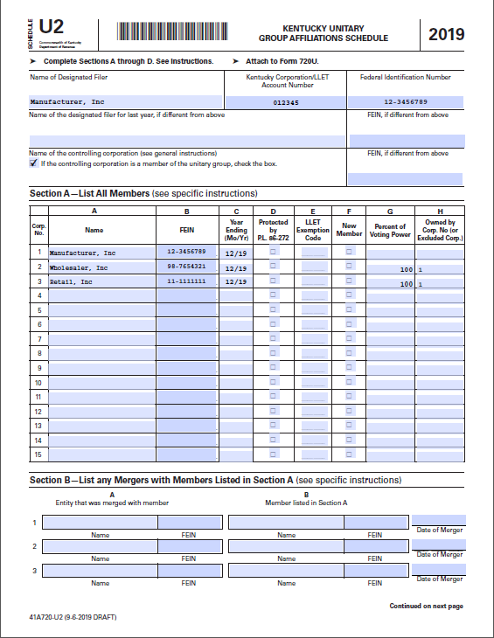
Comprehensive Example

Slide 36
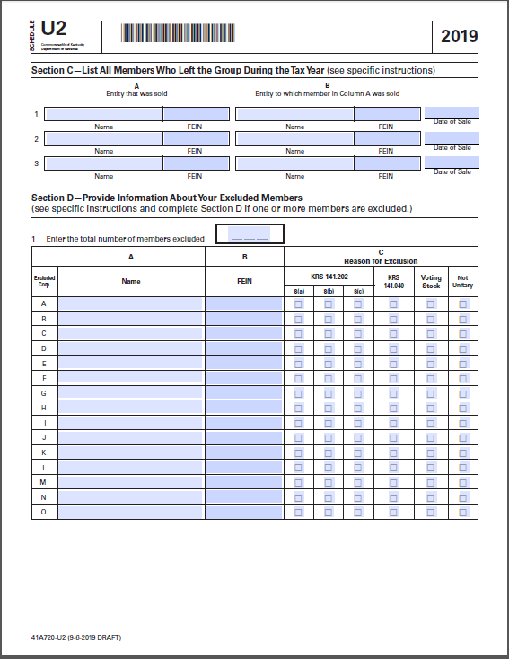
Comprehensive Example

Slide 37
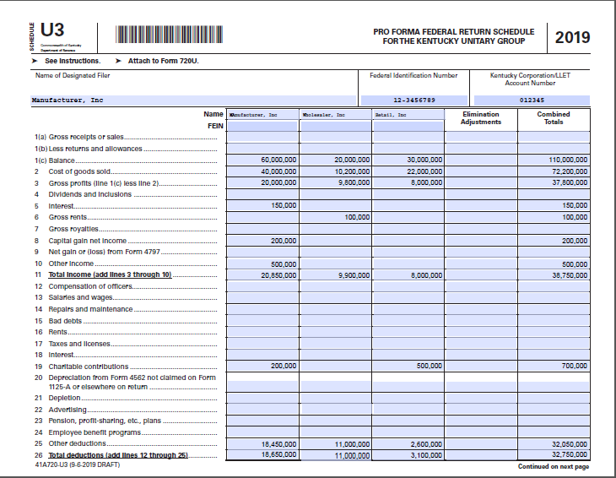
Comprehensive Example

Slide 38
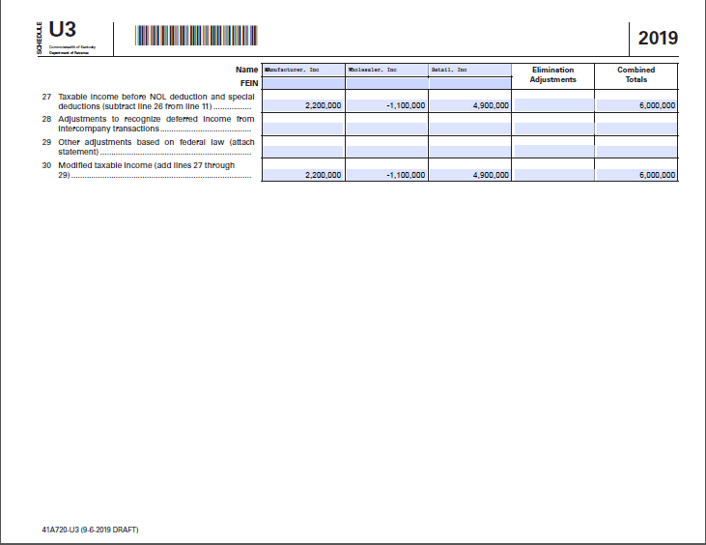
Comprehensive Example

Slide 39
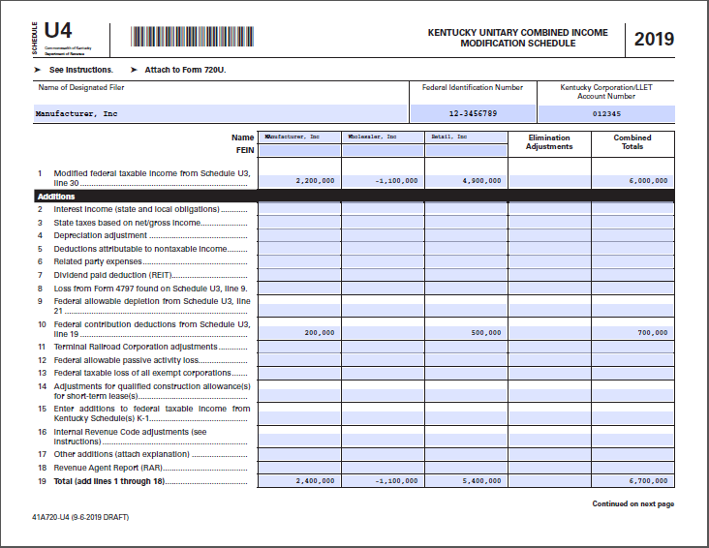
Comprehensive Example

Slide 40
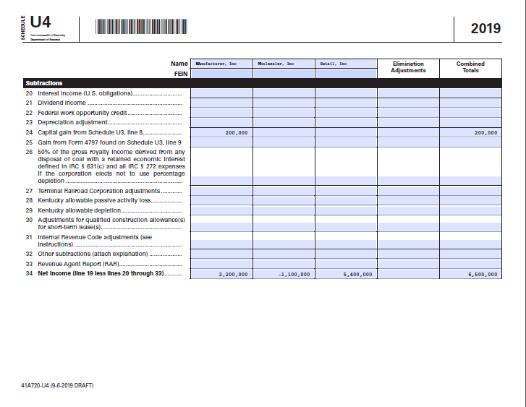
Comprehensive Example

Slide 41
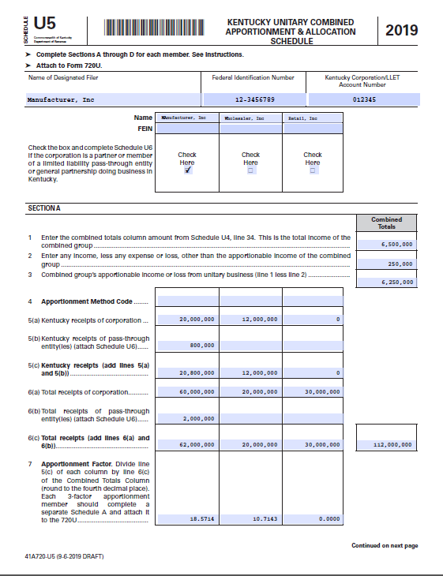
Comprehensive Example

Slide 42
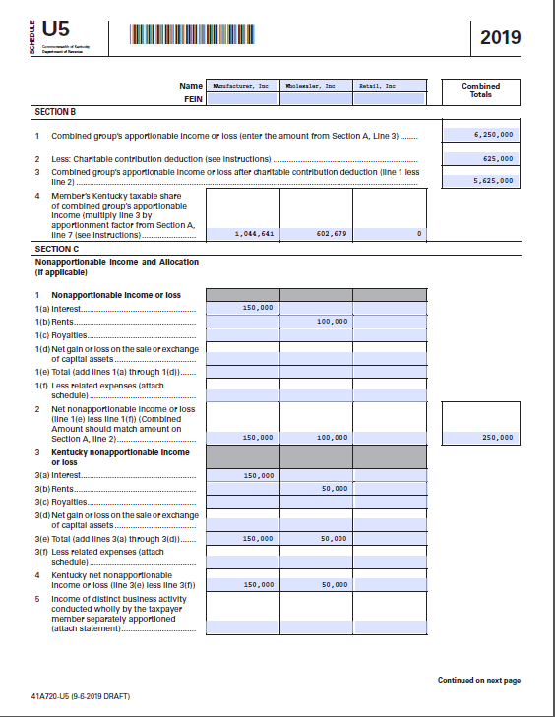
Comprehensive Example

Slide 43
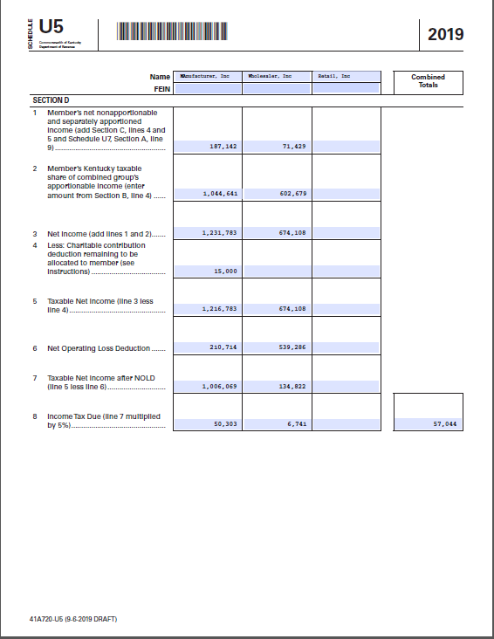
Comprehensive Example

Slide 44
Comprehensive Example
Calculating the charitable contribution deduction
 | Manufacturer | Wholesaler | Retail | Combined Totals
Charitable contributions | 200,000 | 0 | 500,000 | 700,000
Group apportionable income w/o considering contributions |  |  |  | 6,250,000
Allowable contribution deduction per IRC Sec 170 |  |  |  | 625,000
Unused charitable contribution deduction |  |  |  | 75,000*
Pro-rata portion of unused contribution deduction | 21,429** |  | 53,571***
Income allocated to KY | 150,000 | 50,000 | 0
Allowable contribution expense against nonapportionable income | 15,000 | 0 | 0
Unused contribution amount carried forward | $6,429 | 0 | $53,571
*Total contributions of $700,000 minus allowable deduction of $625,000
**(Manufacturer contribution/Total group contribution) X Unused contribution: $200,000/$700,000 X $75,000 = $21,429
***(Retail contribution/Total group contribution) X Unused contribution:
$500,000/$700,000 X $75,000 = $53,571
Retail is not doing business in Kentucky and has no nonapportionable income allocated to Kentucky. No amount of the $75,000 can be used this year, but it can be carried forward.

Slide 45
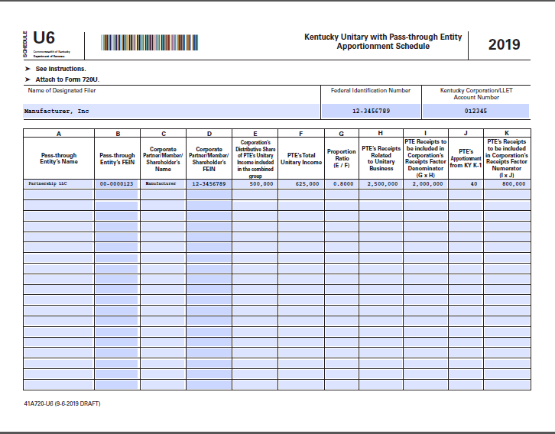
Comprehensive Example

Slide 46
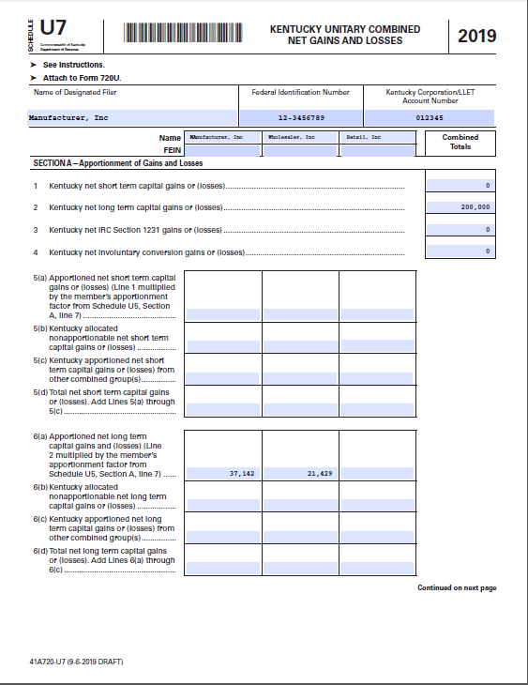
Comprehensive Example

Slide 47

Comprehensive Example

Slide 48
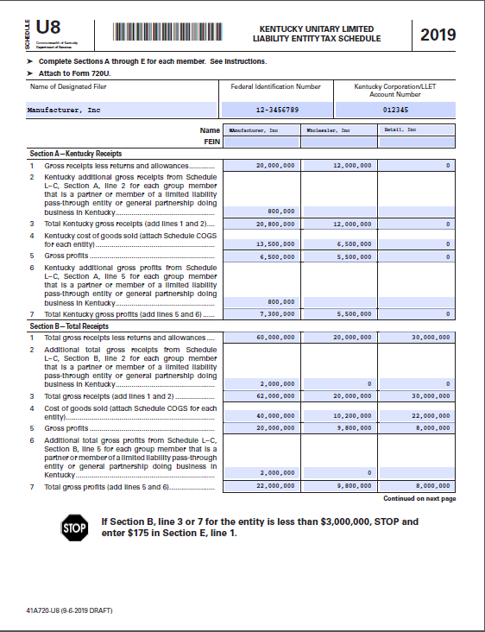
Comprehensive Example

Slide 49
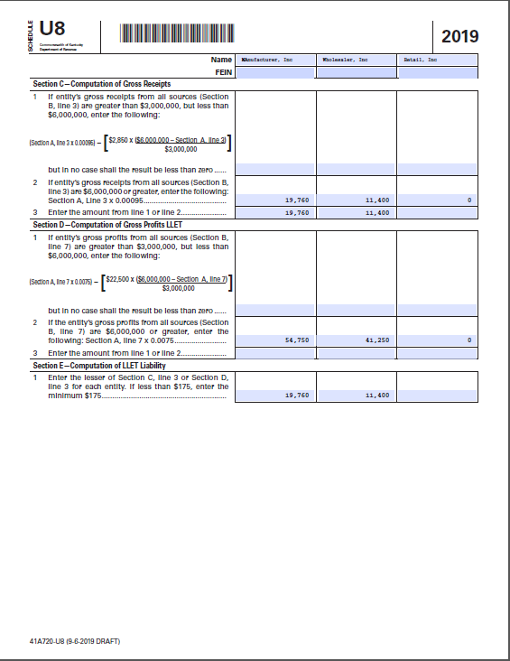
Comprehensive Example

Slide 50
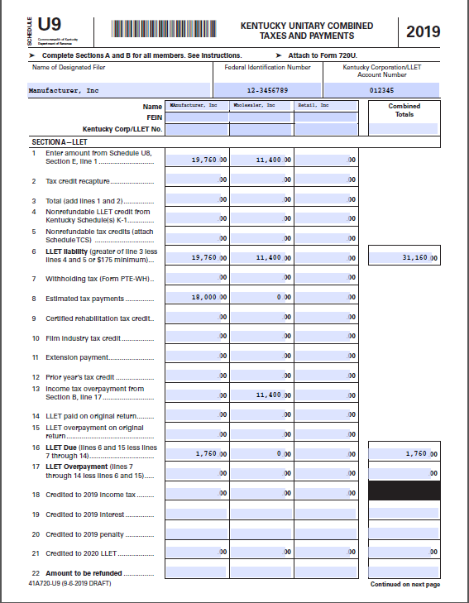
Comprehensive Example

Slide 51
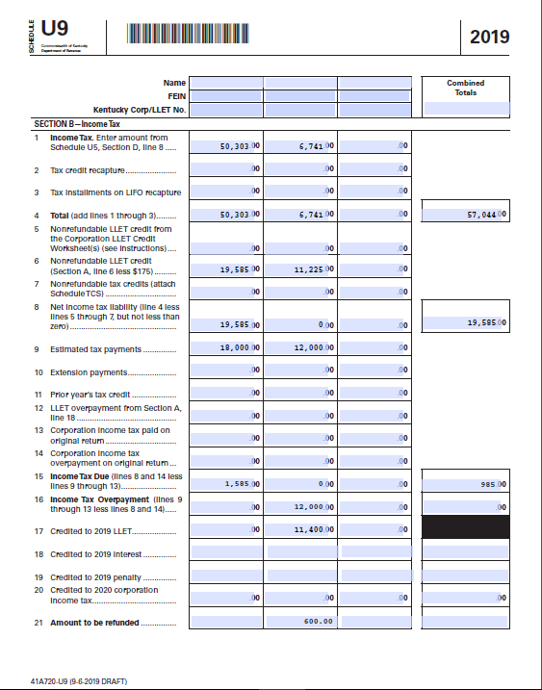
Comprehensive Example
Per the U9 instructions, the combined totals column for Line 16 should reflect the net amount due for the group after subtracting net overpayments.

Slide 52
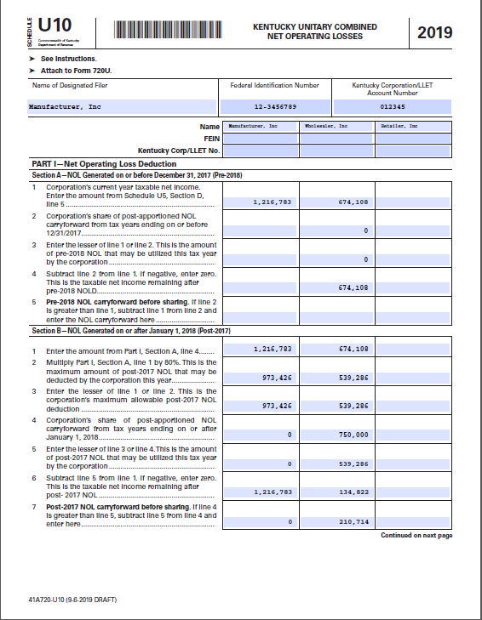
Comprehensive Example

Slide 53
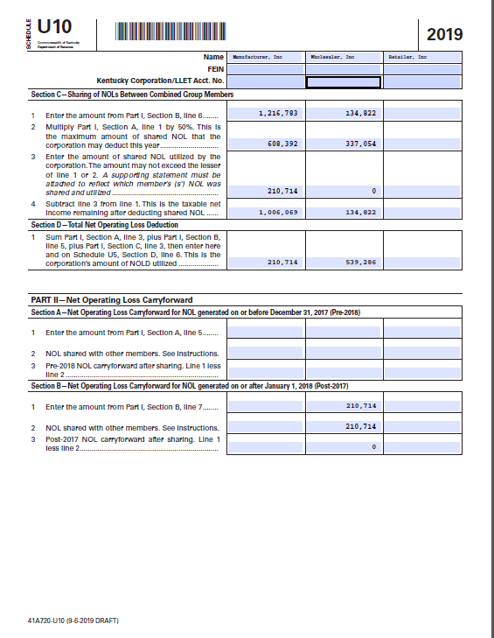
Comprehensive Example

Slide 54
Unitary Combined…unless
KRS 141.201: An affiliated group can “make an election to file a consolidated return with all members of the affiliated group”
  Same-as-federal consolidation… which means the affiliated group may include entities that do not have Kentucky nexus
  What if they don’t file consolidated at the federal level? They can still elect to file consolidated with Kentucky
    The entities in the group would be same as if they filed federal consolidated
  Once they make the election, it is binding for 48 months (4 years)
Otherwise, each entity must file separately if it is not part of a unitary combined group
SO… the default for multi-state corporations is unitary combined, UNLESS they elect out of it and file consolidated
  Otherwise, they file separately
Elective Consolidated statute: KRS 141.201 Regulation: 103 KAR 16:200

Slide 55
Unitary Combined…unless
Differences in Terminology and Concepts
Unitary Combined | Elective Consolidated
“Unitary group” or “Combined group” | “Affiliated group” or “Consolidated group”
“Combined report” | “Consolidated return”
“Subsidiaries have separate identities” | “Treated as a single corporation”
> 50% ownership | >= 80% ownership
Unitary business
Limited sharing of tax attributes | Tax attributes shareable within group
Commonalities:
  Intercompany eliminations
  Not all subsidiaries will have Kentucky nexus

Slide 56
Elective Consolidated
  KRS 141.201(3) states “every corporation doing business in this state” can elect to file “a consolidated return with all members of the affiliated group”
  KRS 141.201 (2)(a) states an “affiliated group” is defined by IRC 1504(a)
  IRC 1504(a) defines an affiliated group as “one (1) or more chains of includible corporations connected through stock ownership with a common parent corporation” with a minimum stock ownership percentage of 80%
  S-Corporations, partnerships, and foreign subsidiaries are not includible corporations [IRC 1504(b)(6)]
  An affiliated group can include entities without Kentucky sales, property, or payroll

Slide 57
Elective Consolidated
    If the consolidated election is made, the affiliated group is “treated for all purposes as a single corporation” (KRS 141.201(4)(b))
      All intercompany transactions are eliminated when computing net income and apportionment factor
      Each member of the affiliated group is “jointly and severally liable” for the group’s income tax liability (KRS 141.201(5))

Slide 58
Elective Consolidated
From the audit point of view:
  A company is included in the affiliated group:
    If the federal affiliation schedule (Form 851) shows the 80%+ ownership structure; AND
    The company files/has filed the appropriate election on Kentucky Form 722
  Again, Kentucky sales, property, or payroll for each entity is not required

Slide 59
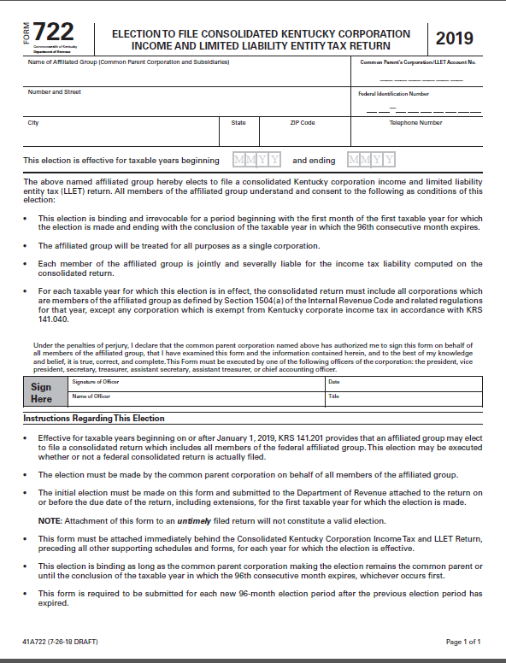
Elective Consolidated—Election Form
DRAFT DRAFT DRAFT DRAFT

Slide 60
Elective Consolidated--Apportionment
  Calculation of the apportionment factor:
    Group’s KY Receipts
    Group’s Everywhere Receipts
    Remember: Single-receipts factor (in most cases)
    Market-based sourcing

Slide 61
Elective Consolidated--Apportionment
  If a group includes both providers and non-providers:
    Members that are providers use three-factor apportionment
    Non-providers use single receipts-factor apportionment
    The apportioned income of both groups are then added together

Slide 62
Elective Consolidated—Apportionment Example
Apportionment: Providers and Non-Providers
The consolidated group consists of Parent and Subs A, B, and C. Subs B and C are providers. Parent and Sub A are not.
Non-Providers | Parent | Sub A | Sub-group totals
Income (after eliminations) | $100,000 | $50,000 | $150,000
KY Receipts | $500,000 | $250,000 | $750,000
Receipts Everywhere | $1,000,000 | $350,000 | $1,350,000
Apportionment Factor |  |  | 56%
Sub-Group Apportioned Income |  |  | $83,333

Slide 63
Elective Consolidated
Apportionment: Providers and Non-Providers Example
Providers | Sub B | Sub C
Income (after eliminations) | $25,000 | $45,000 | $70,000
KY Receipts | $100,000 | $120,000 | $220,000
Receipts Everywhere | $200,000 | $300,000 | $500,000
Receipts Factor |  |  | 44%
Receipts Factor x 2 |  |  | 88%
KY Property | $200,000 | $100,000 | $300,000
Property Everywhere | $1,000,000 | $1,500,000 | $2,500,000
Property factor |  |  | 12%
KY Payrolls | $300,000 | $250,000 | $550,000
Payrolls Everywhere | $1,500,000 | $750,000 | $2,250,000
Payroll factor |  |  | 24%
Apportionment factor |  |  | 31%
Sub-group apportioned income |  |  | $21,700

Slide 64
Elective Consolidated—Apportionment Example
Apportionment: Providers and Non-Providers
Apportioned Income of Non-Providers: $ 83,333
Apportioned Income of Providers: $ 21,700
  Group Taxable Income: $105,033

Slide 65
Elective Consolidated Example
Parent Corp and Subsidiaries A, B, and C are members of an affiliated group
Parent Corp and Subsidiary C are not taxable in Kentucky.
 | Taxable income after KY adjustments | KY receipts | Everywhere Receipts | Group’s Apport. factor | Group’s Taxable Income
Parent Corp | $50,000 |  | $250,000
Sub A | $20,000 | $60,000 | $100,000
Sub B | $40,000 | $60,000 | $180,000
Sub C | ($10,000) |  | $70,000
Group Income (Loss) | $100,000 | $120,000 | $600,000 | 20% | $20,000

Slide 66
Elective Consolidated Return
Loss Limitations
  Designed to prevent profitable corporations from acquiring loss corporations to immediately offset income
  Three provisions that limit group’s use of a new member’s pre-affiliation tax attributes
      Separate Return Limitation Year (SRLY) rules
      Built-In Deduction
      Section 382 Limitations

Slide 67
Elective Consolidated Return
  Separate Return Limitation Year (SRLY) rules:
    If a tax attribute (credit, NOLs, etc.) originated in a year when the member corporation was not in the affiliated group,
    Then it can only offset group income up to the amount of income contributed by the formerly separate member in the consolidated year
        Treat the tax attribute as if the member had filed a separate return

Slide 68
Elective Consolidated Return
  Built-In Deduction:
    Occurs when a loss is accrued in a separate-return year and carried into a consolidated return year.
    Generated when book value of the assets of an acquired corporation is less than the fair market value
    The economic loss is not realized until the assets are sold, so there is a “built-in” deduction
    When assets are sold, the portion of the realized loss that was accrued before the date of acquisition can only offset group income up to the amount of income contributed by the member that sold the assets

Slide 69
Elective Consolidated Return
  Section 382 Limitations:
    Triggered by changes in ownership
      When any one or more 5% (by value) shareholders increase their holdings over a three-year period by more than 50 percentage points
    Limits use of losses from a newly acquired company by the group
      Calculated based on the fair market value of the acquired corporation multiplied by the highest Federal long-term tax-exempt interest rate
      26 C.F.R. 1.1502-94

Slide 70
Filing an Elective Consolidated Return
Common Parent
  The common parent files the consolidated return on behalf of the affiliated group
  Even if the parent does not have nexus in KY
  So the parent must have a KY corporate tax account number

Slide 71
Filing an Elective Consolidated Return
  Form 722
    Must be filed on or before the due date (or extended date) of the return of the first tax year for which the election is made
    A copy of the initial election form must be attached to the return for each year the election is effective
    Election is binding and irrevocable
    Election period is four years (48 months)
    Failure to file Form 722 means no election has been made
      Failure to file 722 at the expiration of an election period means no subsequent election has been made
        Continuing to file Elective Consolidated in Year 5 is not sufficient

Slide 72
Filing an Elective Consolidated Return
  Common Tax Year:
    Each member of the affiliated group must utilize the common parent’s tax year
      Although members can use different accounting methods
  Newly Acquired Corporations:
    Must join the existing group election and adopt the common parent’s tax year

Slide 73
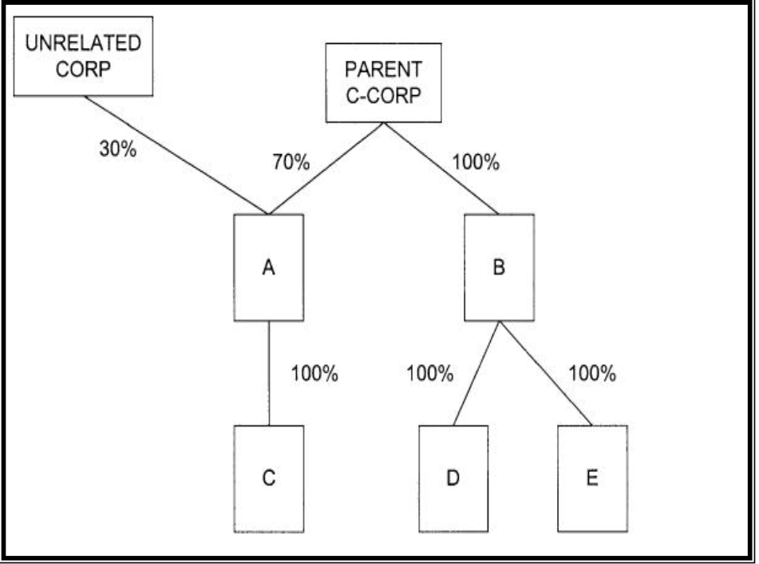
Example #1
All companies are C-Corps
E has no sales, property or payroll in KY. All other corporations have KY nexus.
A vertically integrated plastics manufacturer
Unrelated Corp sells 80% of its output to A, which is domiciled in Kentucky
Which entities would be included in:
  Mandatory Nexus Return?
  Elective Consolidated Return?
  Unitary Combined Return?

Slide 74
Example #1
Mandatory Nexus: Group 1 = (Parent + B + D ) Group 2 = (A + C) E has no filing obligation
Elective Consolidated: Group 1 (Parent + B + D + E)
  A + C could make a separate election to file consolidated, OR
  A + C could file as a separate combined group (unless there is no unitary business)
Unitary Combined: All corporations are included, except Unrelated Corp
Unrelated Corp would have a filing obligation in KY due to sales in the state

Slide 75
Example #2
All companies are C-Corps
E does not have sales, property, or payroll in KY
Parent is a holding co without KY nexus
Sub A and affiliated companies manufacture and sell auto parts
Sub B and affiliated companies recycle plastic and metal and sell recycled products
Percentages reflect voting stock ownership
51%
49%
Which entities would be included in:
  Mandatory Nexus Return?
  Elective Consolidated Return?
  Unitary Combined Return?

Slide 76
Example #2
51%
49%
Mandatory Nexus: Group 1 = (Sub A + Sub C). Group 2 = (Sub B + Sub F). Sub D = Separate filer. Sub E = no filing obligation
Elective Consolidated: Group = (All entities)
Unitary Combined: Depends on the fact pattern (Is it a unitary business?)
  Group 1: (Parent + Sub A + C + D) Group 2: (Parent + Sub B + E + F)?
  Group = (All entities)?

Slide 77
Example #3
All companies are C-Corps
Company provides software (both physical media and cloud-based) and technical service to clients
E is domiciled in Kentucky but makes 90% of its sales to overseas customers
Which entities would be included in:
  Mandatory Nexus return?
  Elective Consolidated Return?
  Unitary Combined Return?

Slide 78
Example #3
Mandatory Nexus: Group 1 (Parent + B + C + E) Separate filer = D No filing obligation = A
Elective Consolidated: Group = (All Entities)
Unitary Combined: Group = Parent + A + B + C + D. Company E is not included in the combined group because of the 80/20 rules, but it still has a KY filing obligation

Slide 79
Example #4
Company provides dialysis services through local clinics
LLC 3 does not have sales, property, or payroll in KY
Which entities would be included in:
  Mandatory Nexus Return?
  Elective Consolidated Return?
  Unitary Combined Return?

Slide 80
Example #4
  Mandatory Nexus: Group = (C Corp + LLC 1) + (Distributive share of income of LLC 2)
  Elective Consolidated: Group = (C Corp + LLC 1) + (Distributive share of incomes of LLC 2 & LLC 3)
  Unitary Combined: Group = Same as Elective Consolidated

Slide 81

Questions, Comments, or Concerns
Thank You!

